Slide 1

Ayodhya Ram
Temple Analysis

Slide 2

Challenge
The challenge is to craft SQL queries to extract insights from the Ayodhya Ram Temple database.
Presented By
Kamutam Litheeshwar

Slide 3
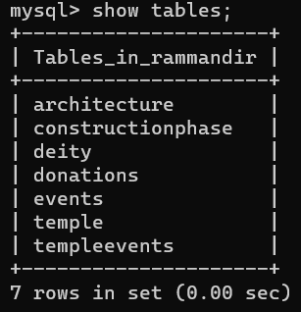
Tables

Slide 4
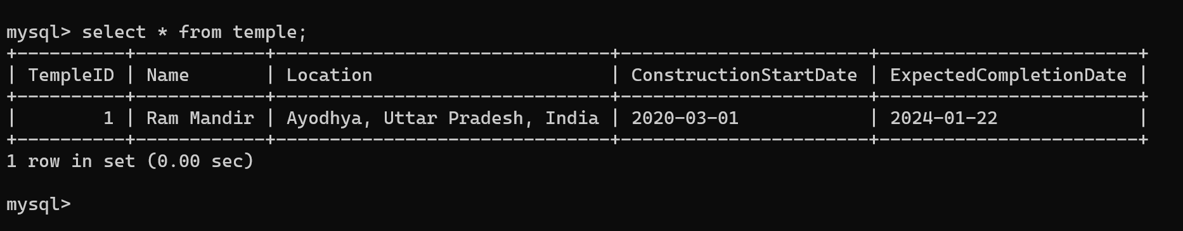
1)Retrieve information about the Ram Mandir?

Slide 5
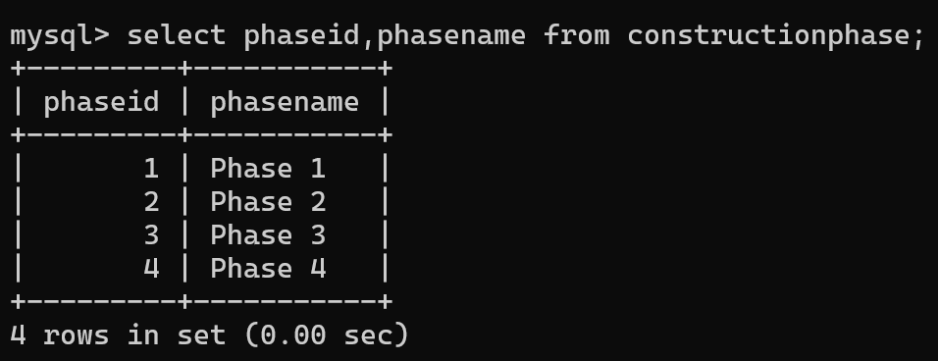
2)List all construction phases for the Ram Mandir?

Slide 6
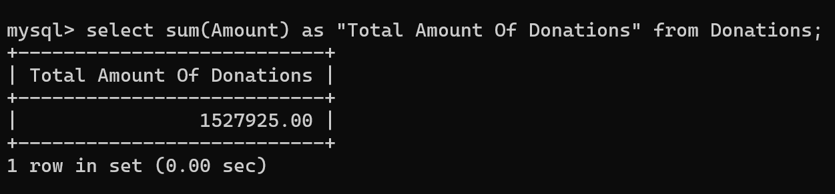
3)Find the total amount of donations received for the Ram Mandir?

Slide 7
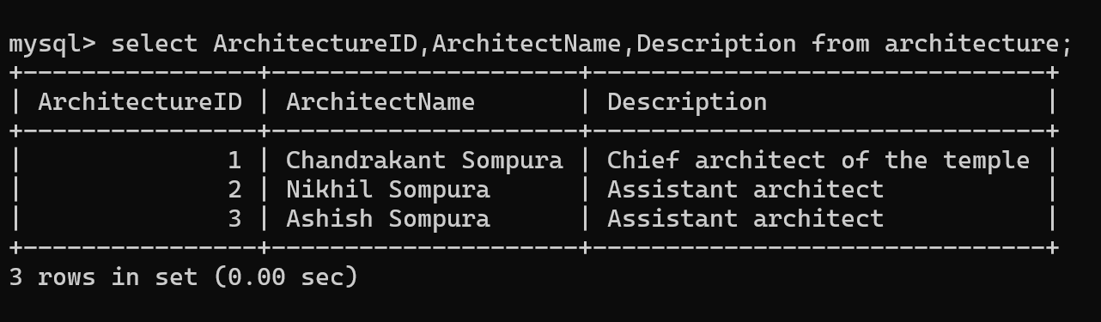
4)Get details about the architecture of the Ram Mandir?

Slide 8
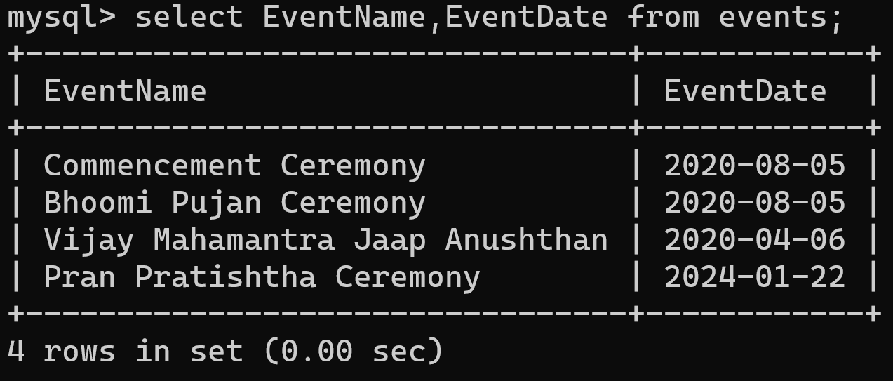
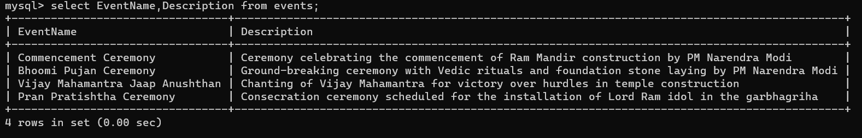
5)Retrieve events associated with the Ram Mandir?

Slide 9
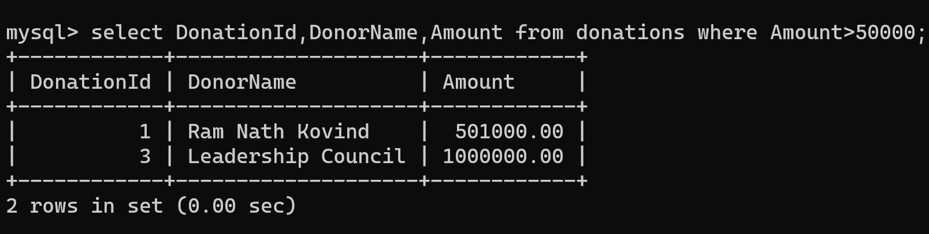
6)Find donors who contributed more than 50000 towards the Ram Mandir?

Slide 10
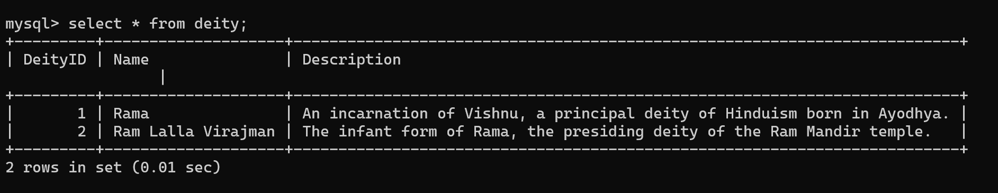
7)Retrieve details about a specific deity (e.g., Rama) ?

Slide 11
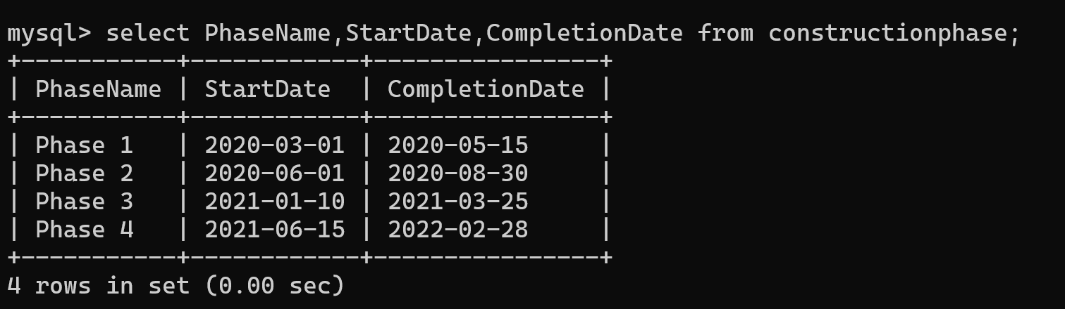
8)Find the start and end dates of the construction phases for the Ram Mandir?

Slide 12
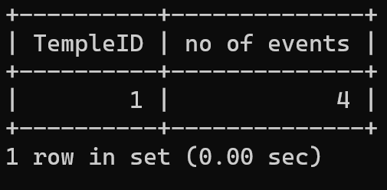
9)Count the number of events associated with each temple?

Slide 13
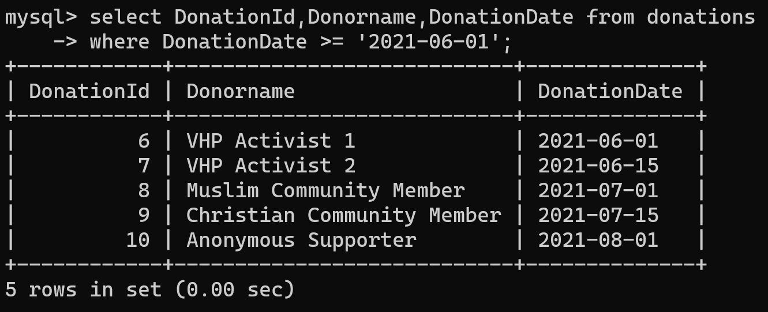
10)Find the donors who made contributions on or after 2021-06-01?

Slide 14


Thank You
Nitish Kumar
Digits n Data

